Slide 1
Development Madrugada 2019

Slide 2
Clinical machines installation

Slide 3
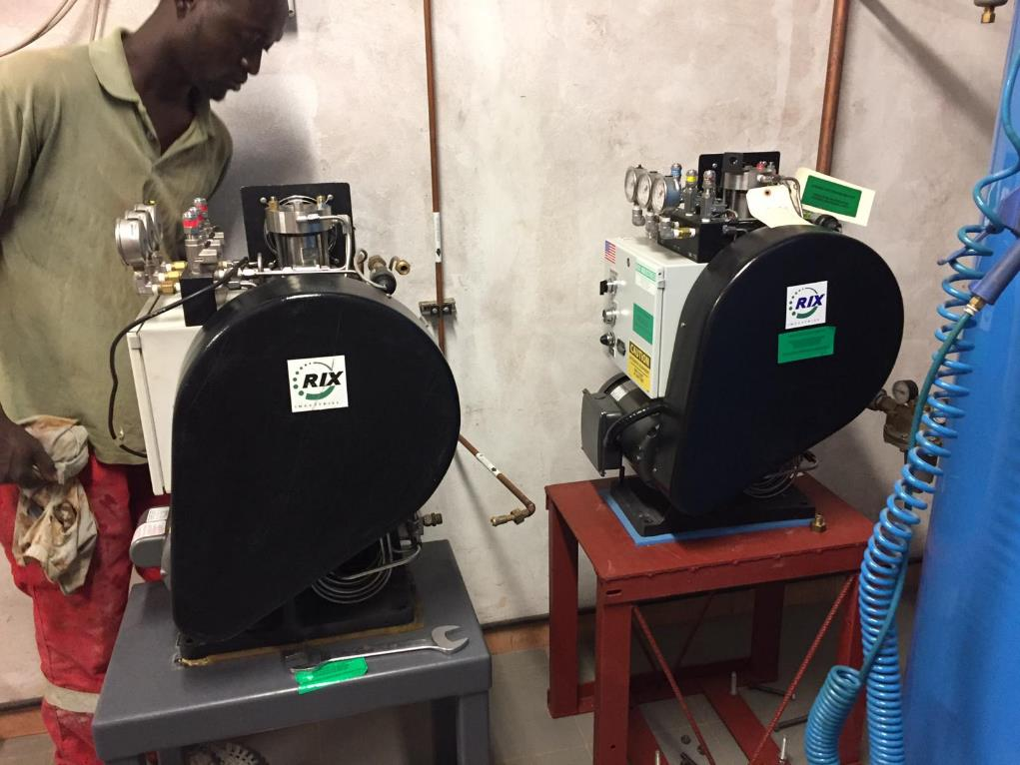
New medical oxigen compressor Rix Industries; we are showing two boosters, the new one and the old one we keep as replacement

Slide 4
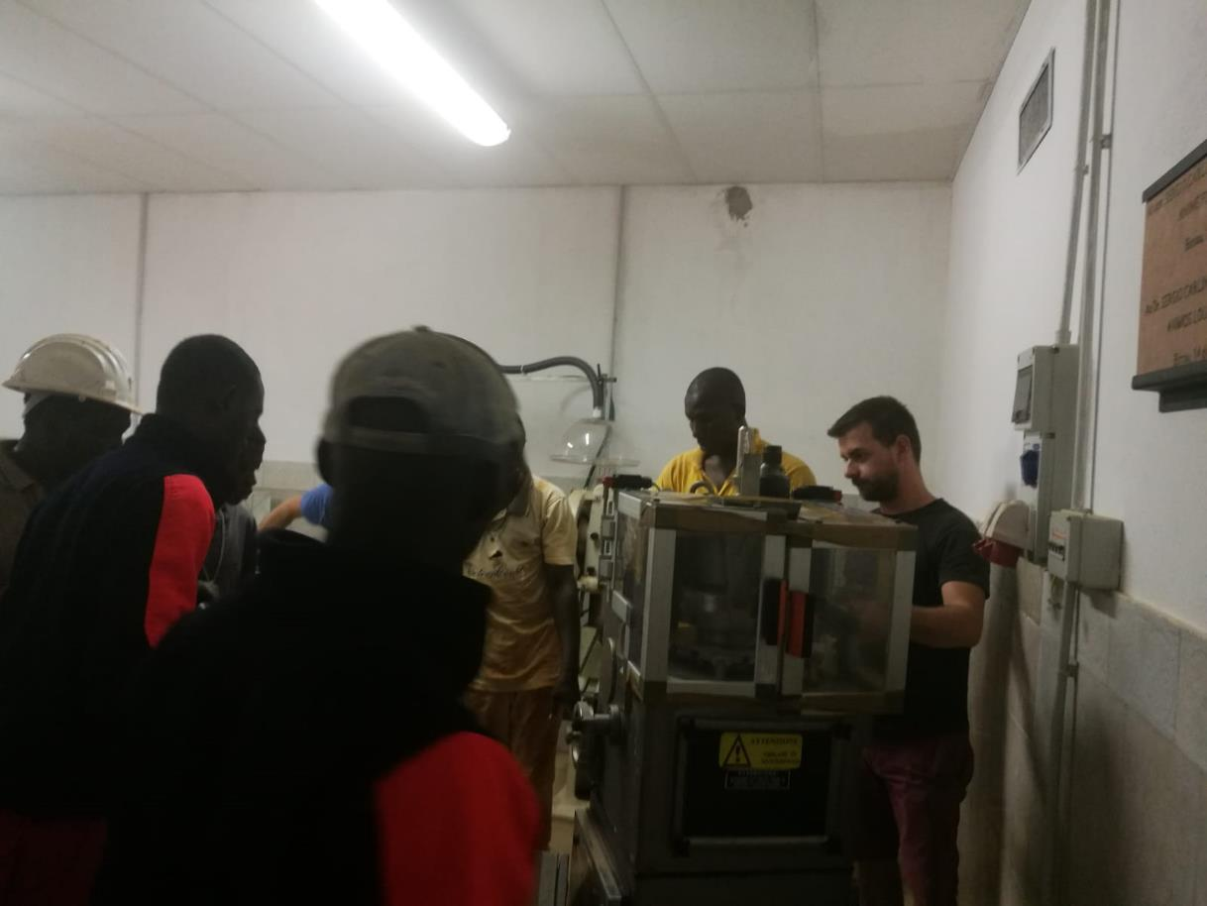
Tablet press installation

Slide 5
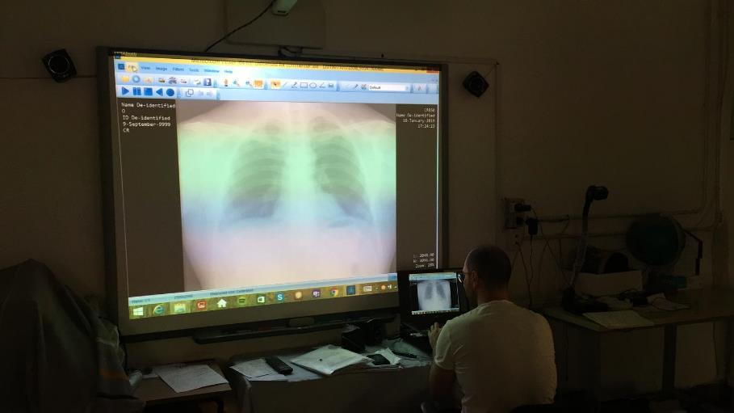
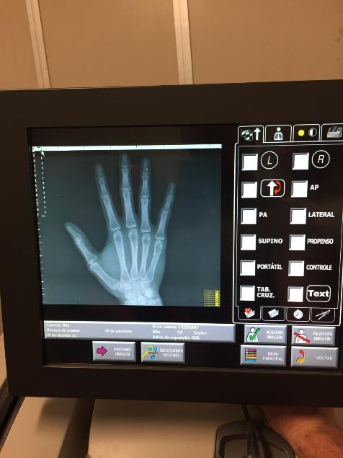
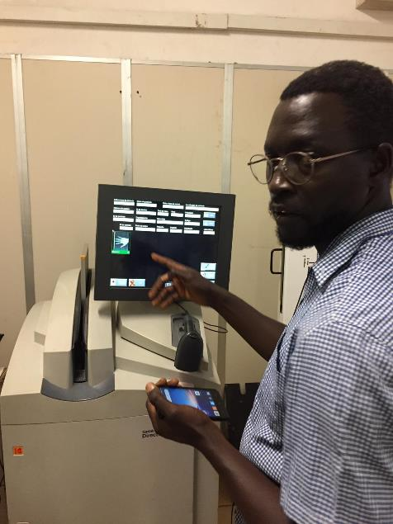
Radiographs digitalization; now it is possible to send them in high resolution electronically in order to be analysed

Slide 6
Pharmaceutical production

Slide 7
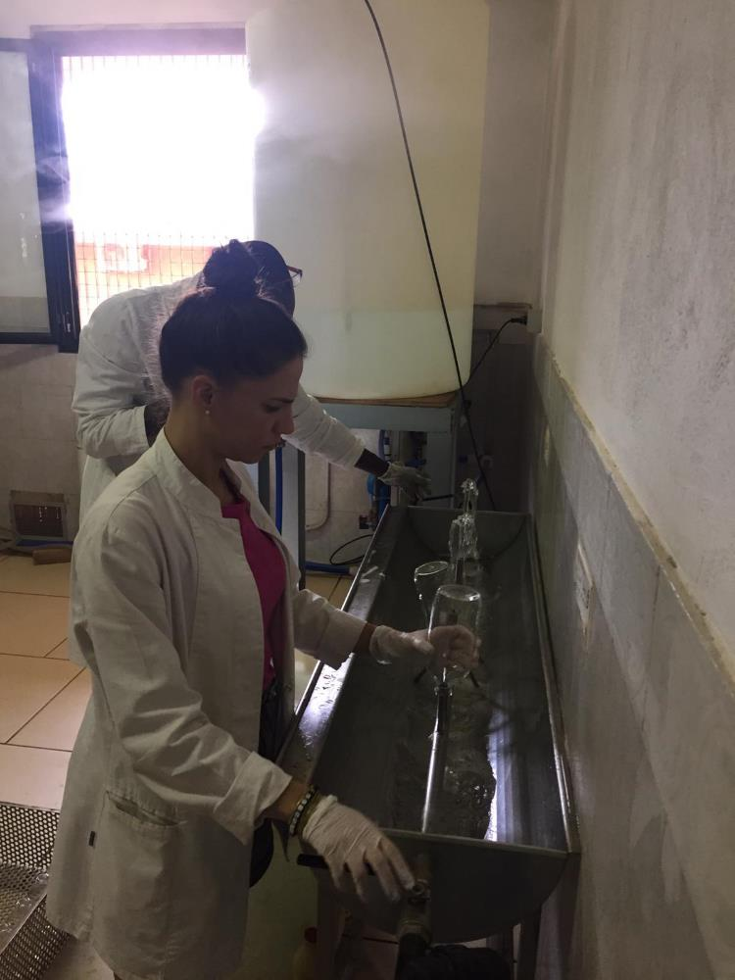
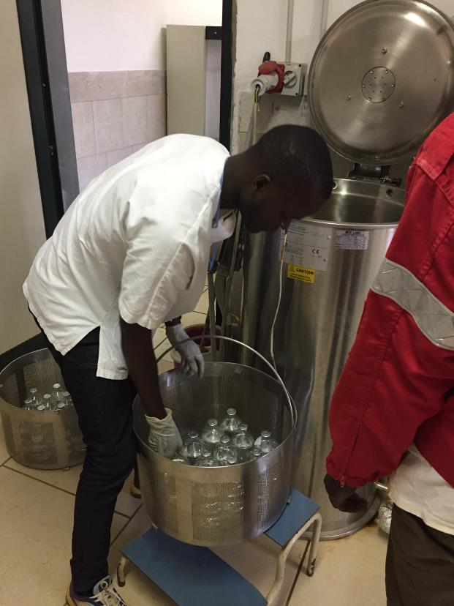
Phleboclysis production (5% glucose and 0,9% saline)

Slide 8
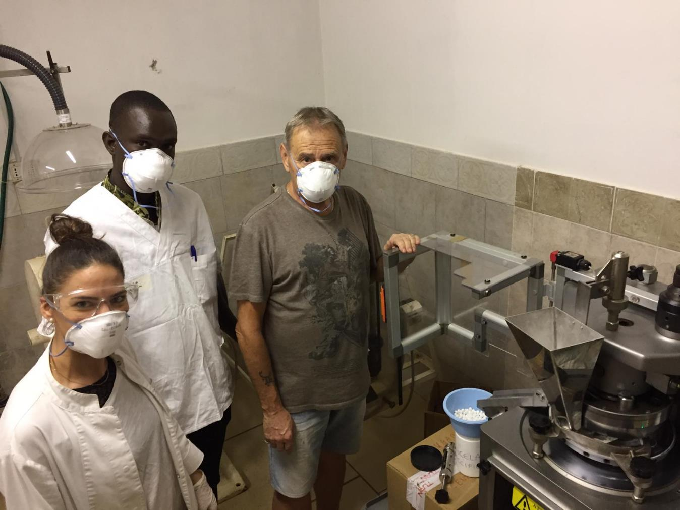

Slide 9
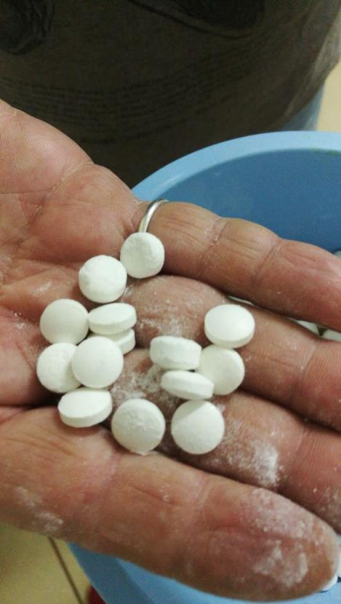
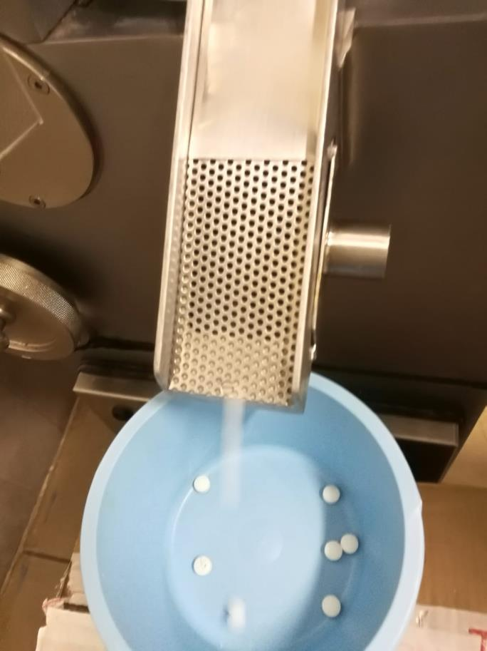
Tablet press cleaning and tablet production (donated by Aptuit-GSK)

Slide 10
Pharmacy management system
Drugs inventory and sotwear training to the staff

Slide 11
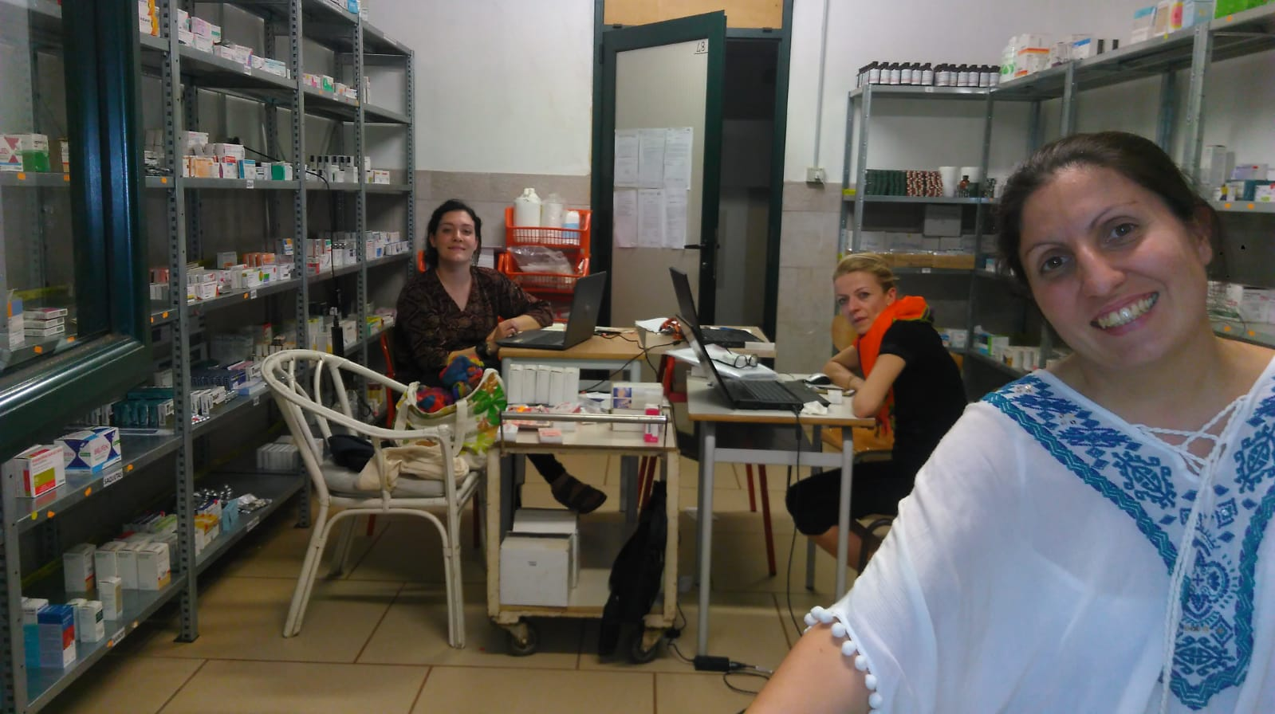

Slide 12
Laboratory
Clinical Chemistry Immunometric analyzer installation named «miniVIDAS Biomerieux» and training to Madrugada staff.

Slide 13
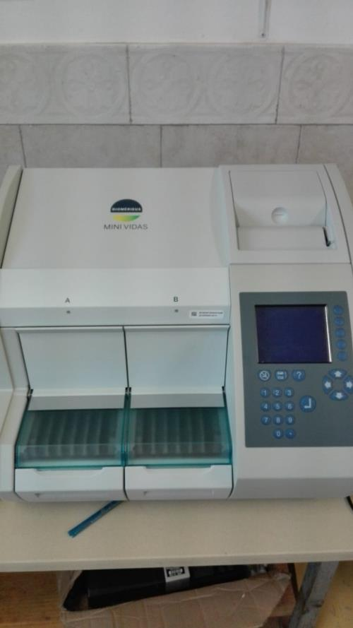
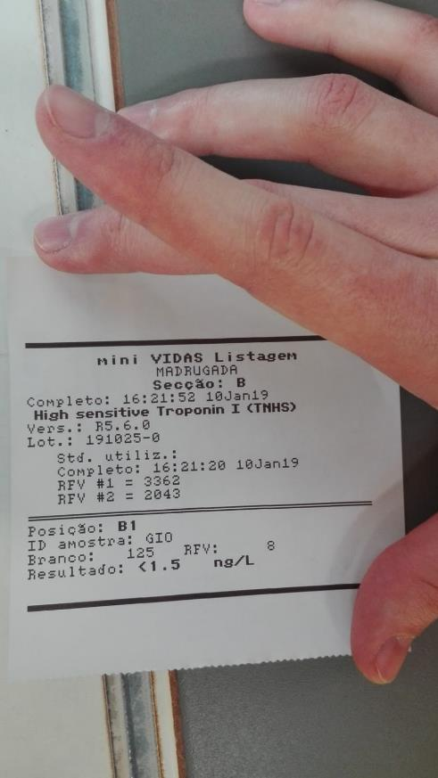
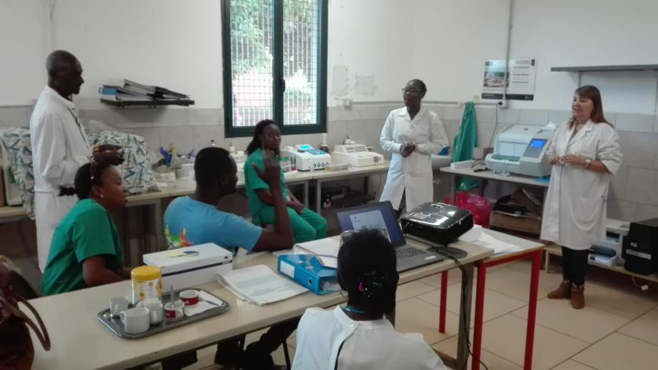

Slide 14
Tailoring

Slide 15
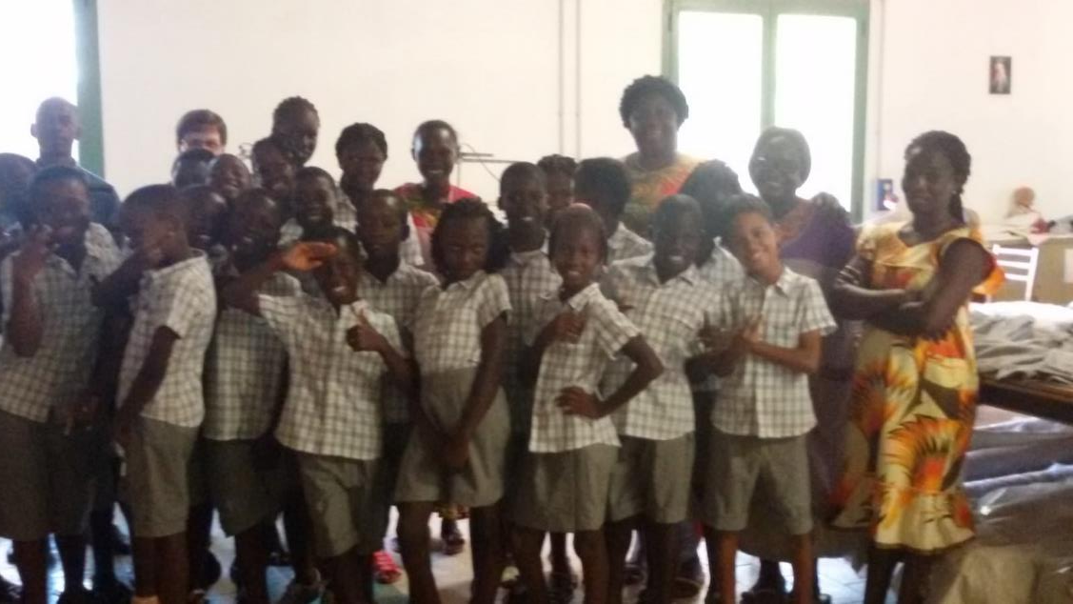
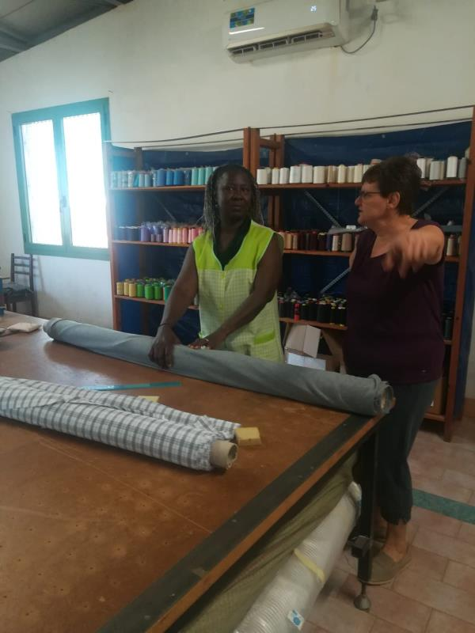
The taloring continues the clothes production…
Primary school uniforms produced internally by the guinean tailors working in Madrugada.

Slide 16
Training courses

Slide 17
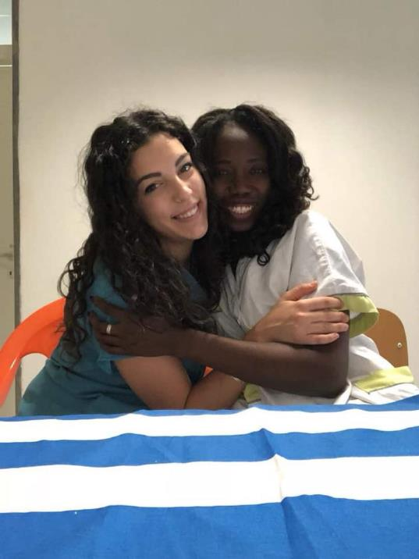
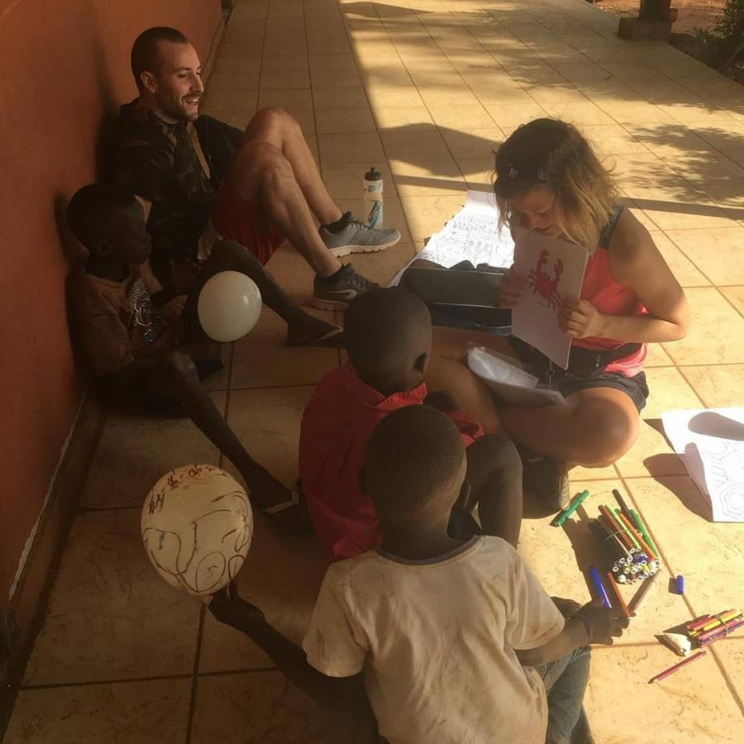
Psychomotrictiy course with primary school students
Collaboration between the Italian and local specialist nurses

Slide 18
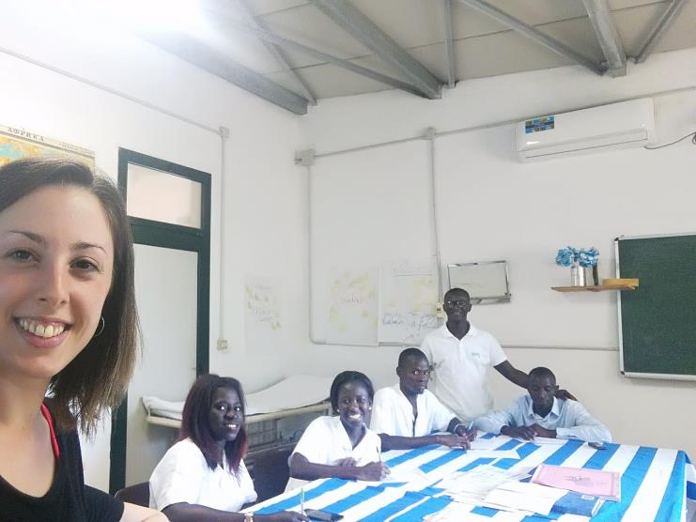
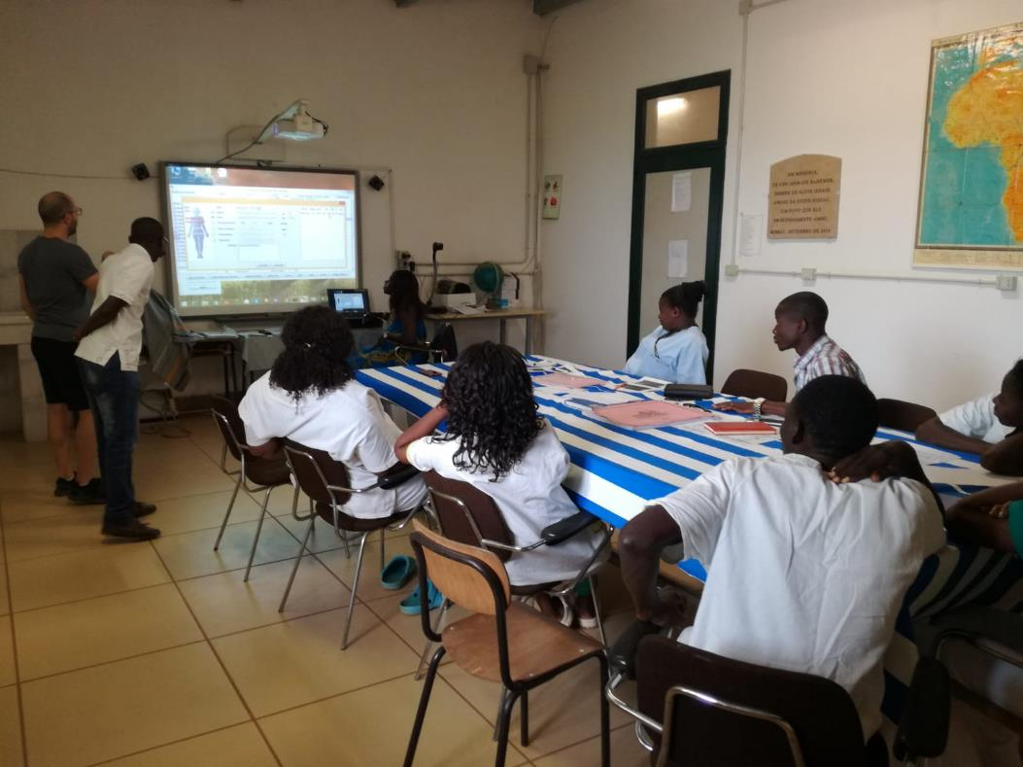
Traing concerning the open source IT platform «Open Hospital» to the nurses.
Basic psychiatric pathology course delivered by the Neuropsychologist Giorgia to medical staff

Slide 19
Project with the students of «Istituto Uselli-Ruzza di Padova»

Slide 20
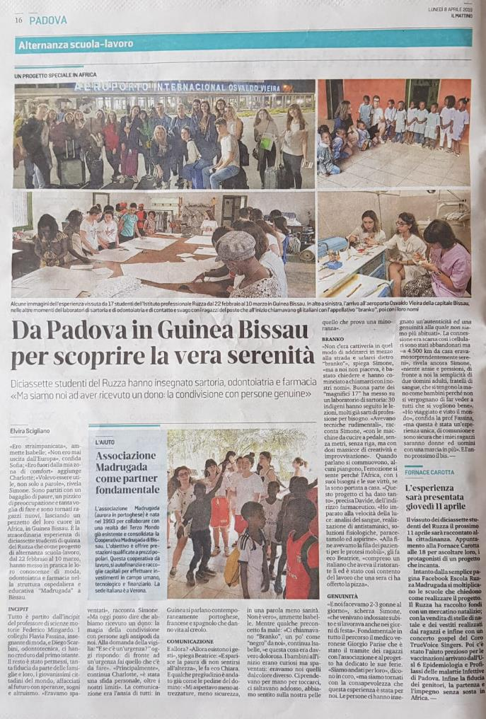
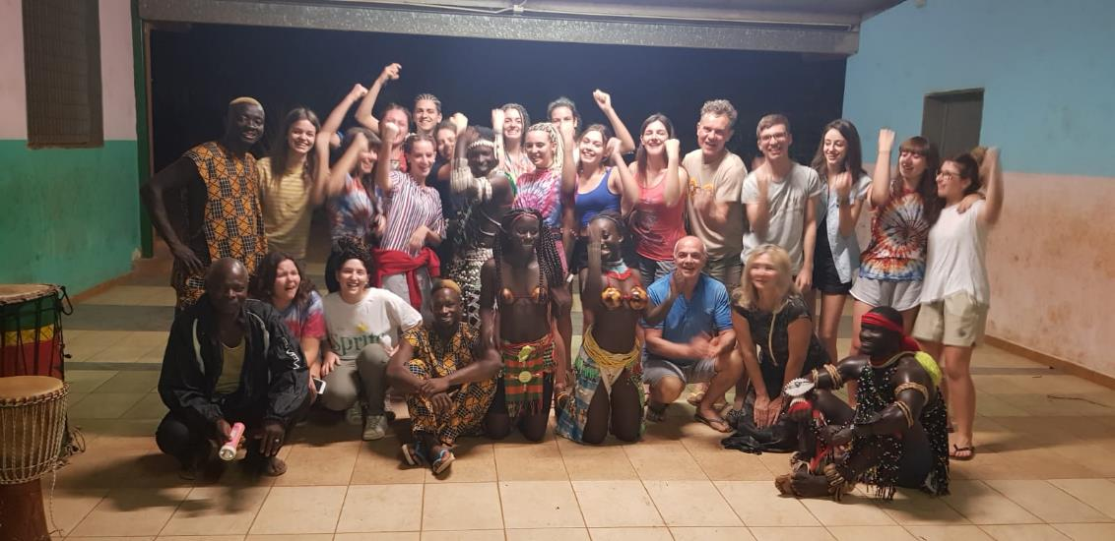
School/work alternation training Project with «Istituto Usuelli-Ruzza - Padova» in Madrugada

Slide 21
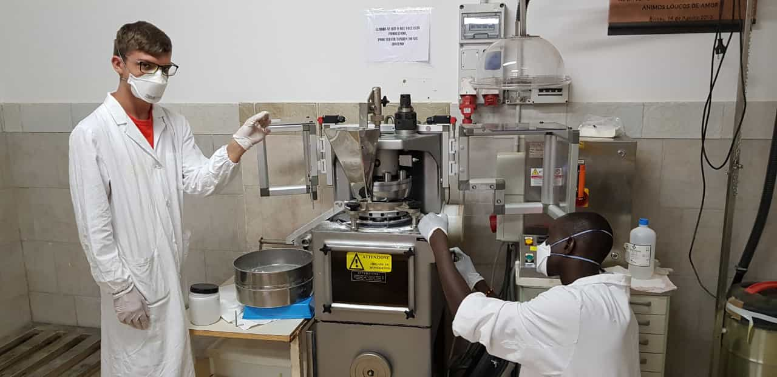
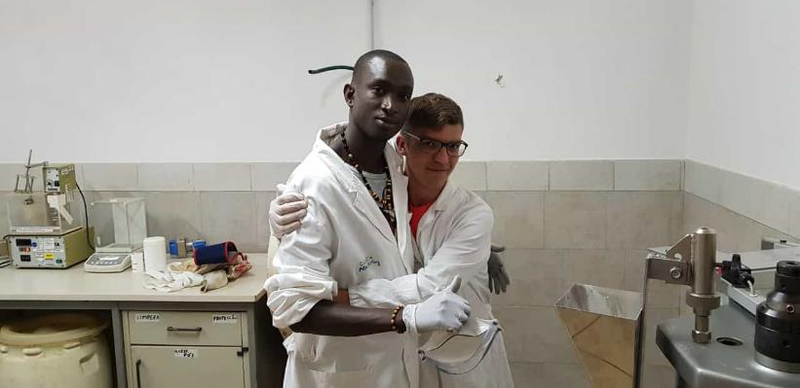
Phleboclysis production thanks to the collaboration between the students and the local staff

Slide 22
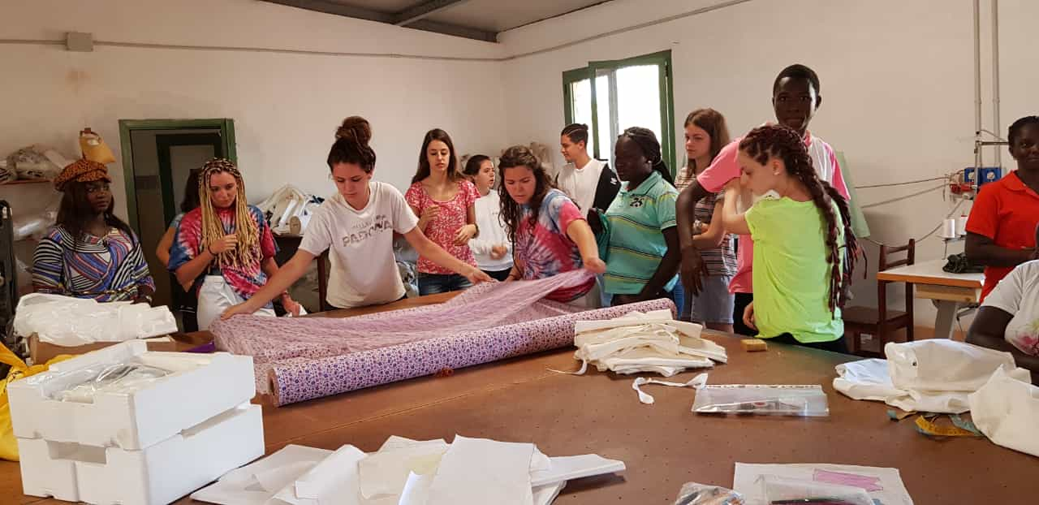
The students are working in the tailoring….

Slide 23
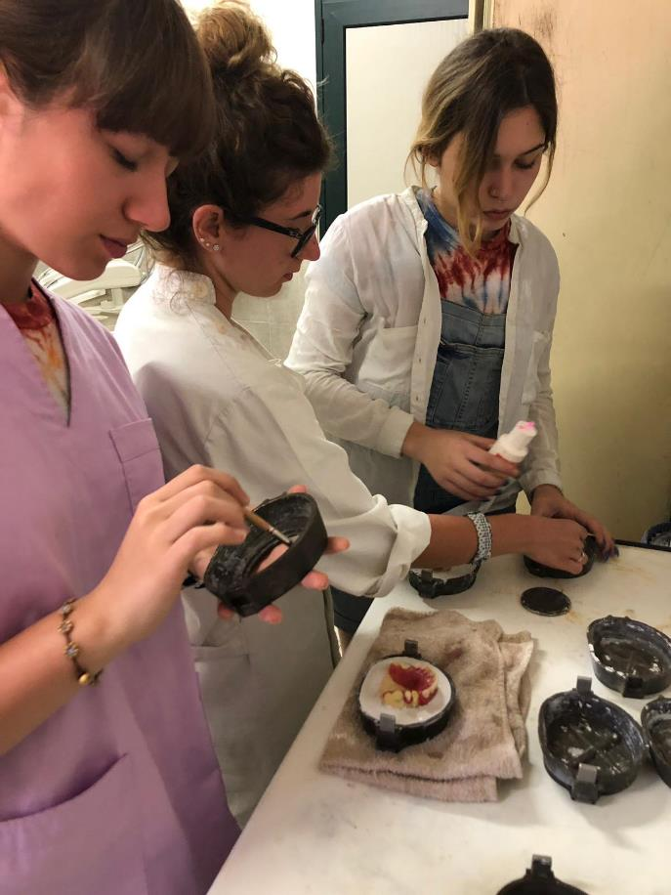
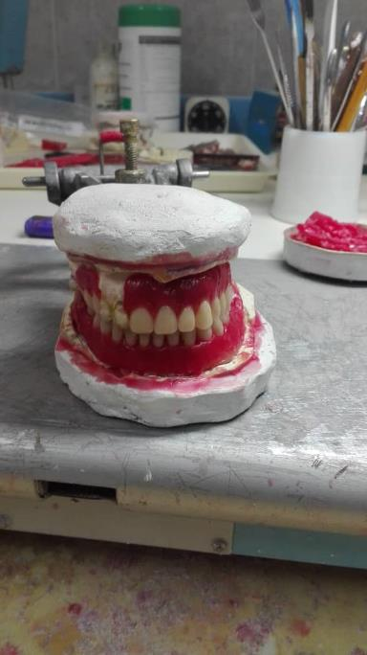
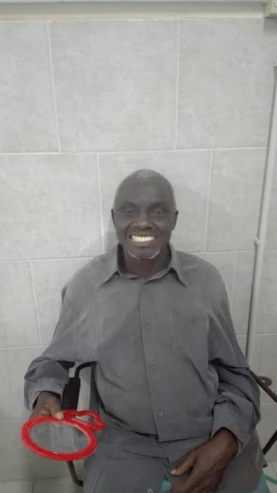
A primary school professor of Safim (near Bissau airport) finally with all his teeths: the work has been done in the Campus Madrugada dental clinic thanks to Dr. Leonilda (Nina) and the students.

Slide 24
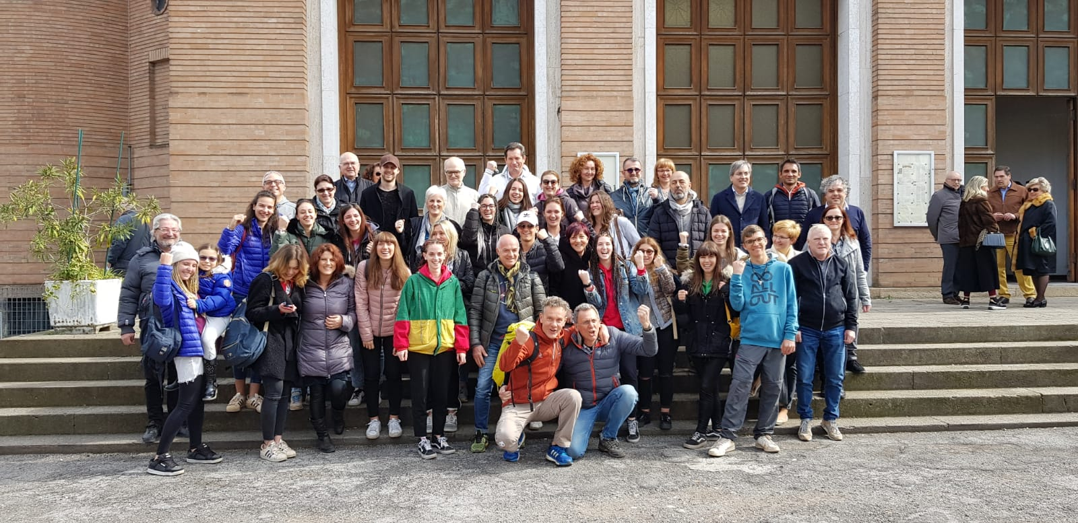
… back to Padova

Slide 25
Bread production on going…

Slide 26
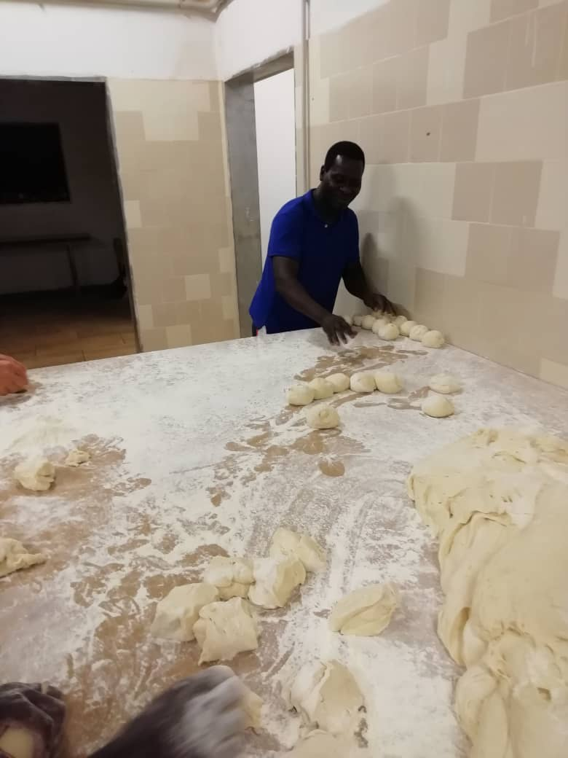
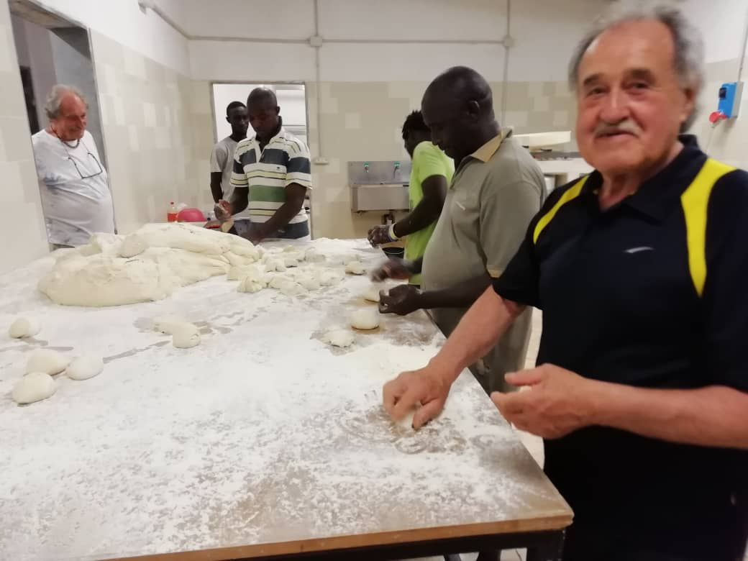

Slide 27
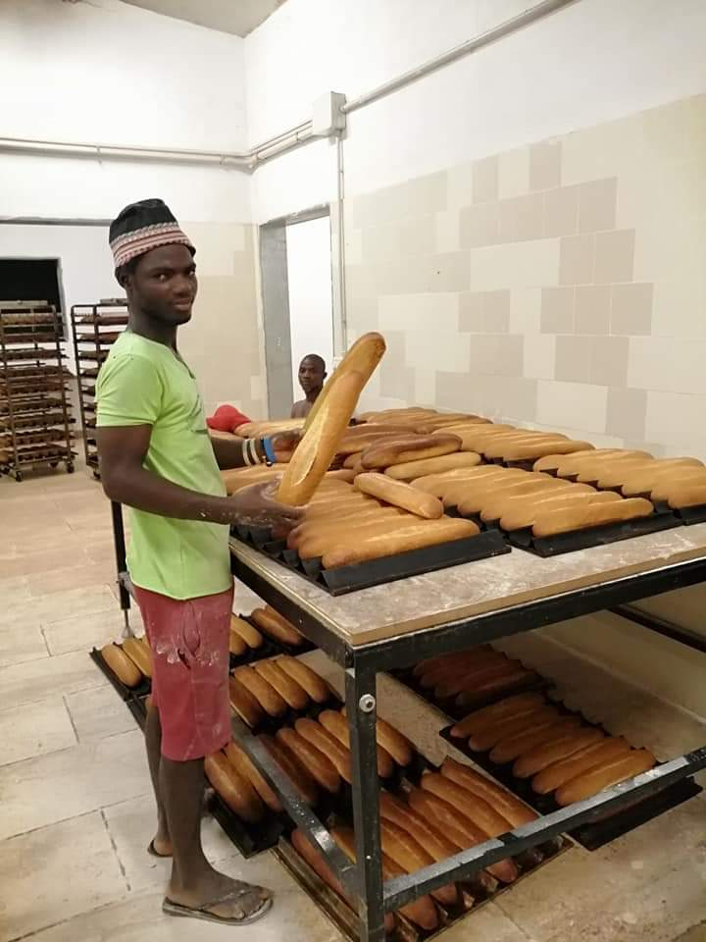
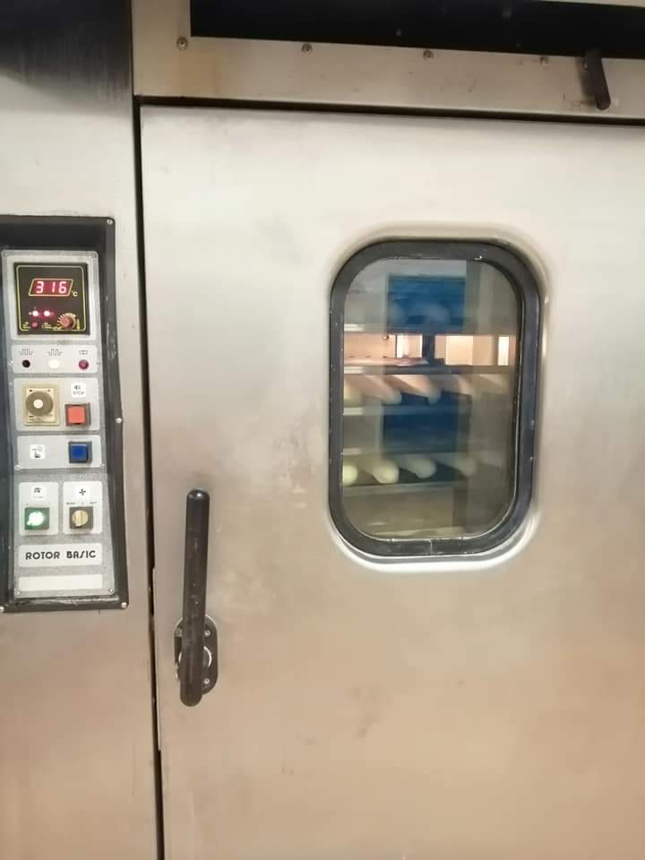
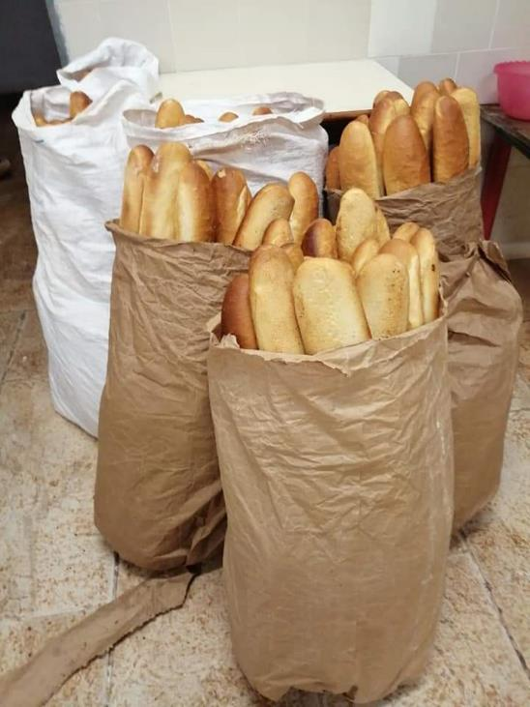

Slide 28
New equipements for the clinic

Slide 29
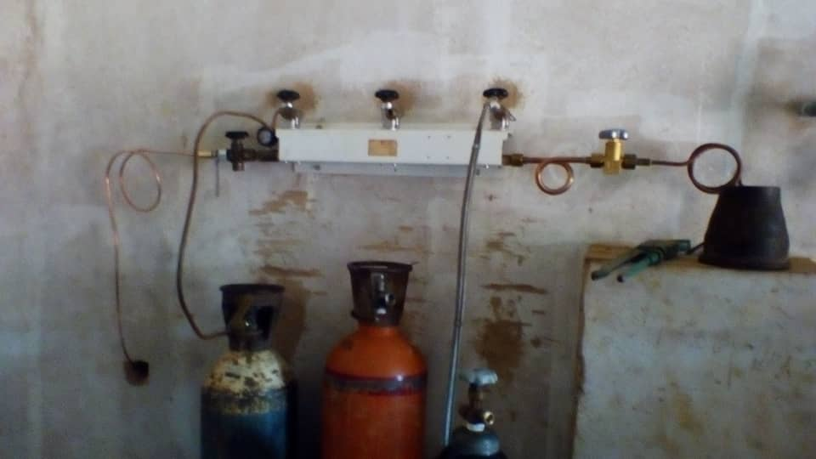
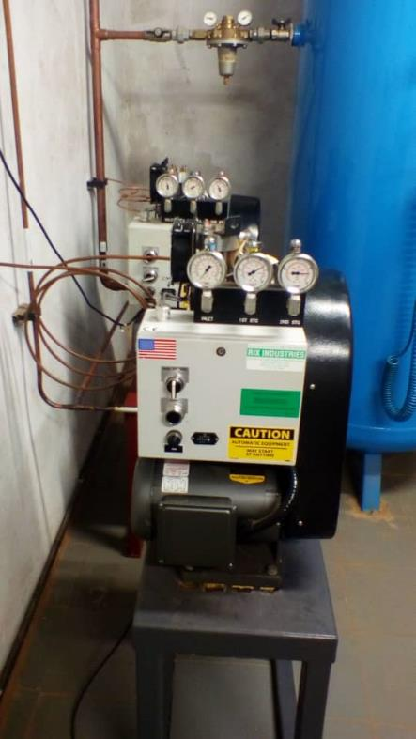
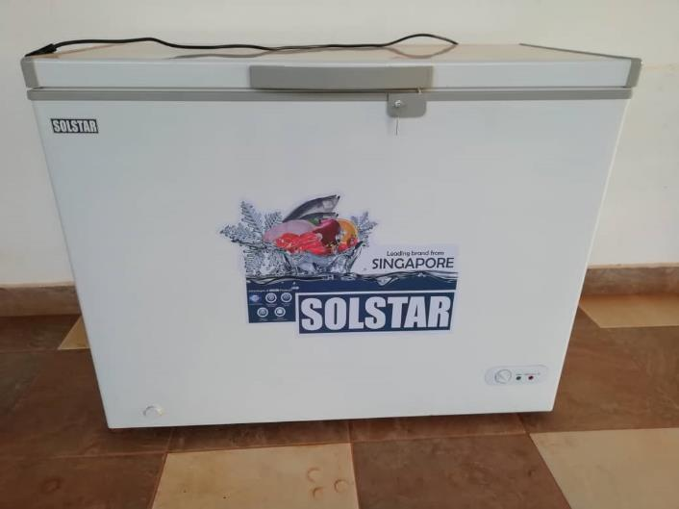
New freezer in the porch
The two boosters for oxigen tank charge are working concurrently

Slide 30
Meeting with portuguese business managers

Slide 31
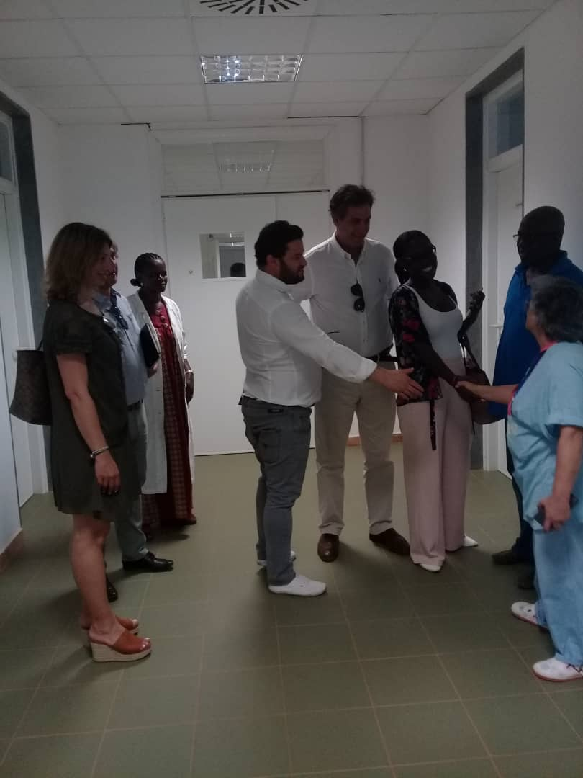
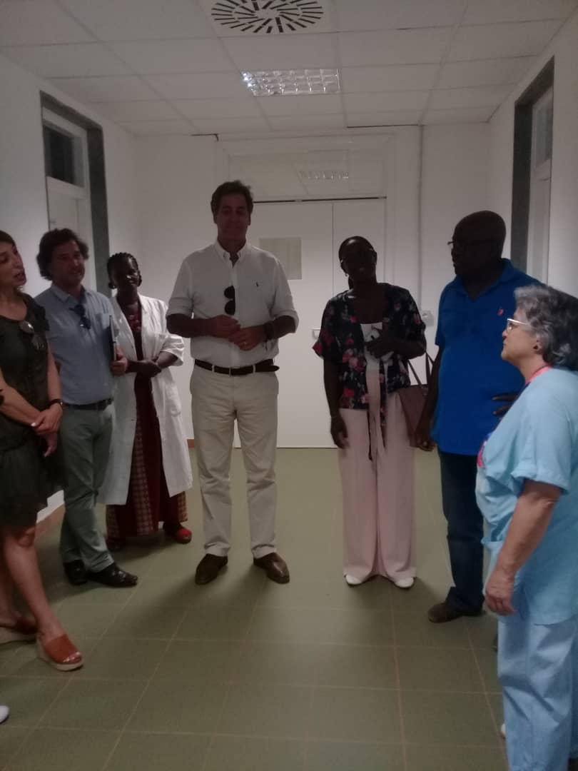

Slide 32
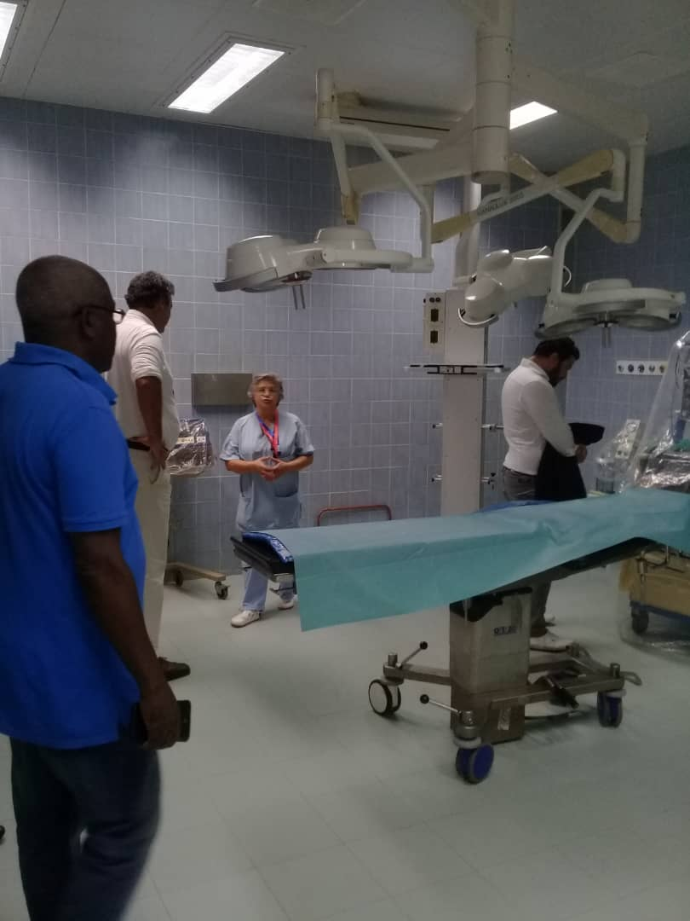
The THL (Tecnologia Hospitalar e Laboratorial) Managers, one of our first suppy of reagents for the laboratory, visited Madrugada

Slide 33
The carpentry works
The campus in evolution…

Slide 34
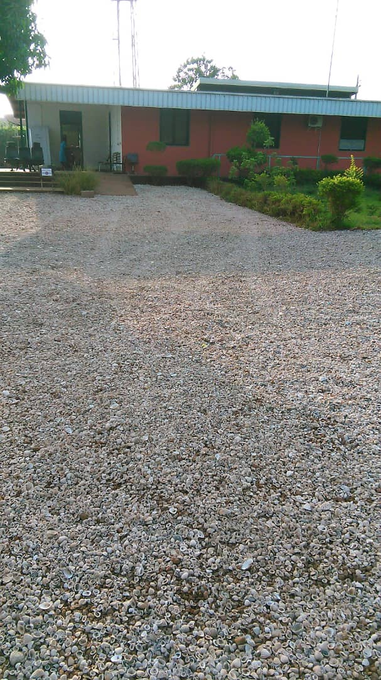
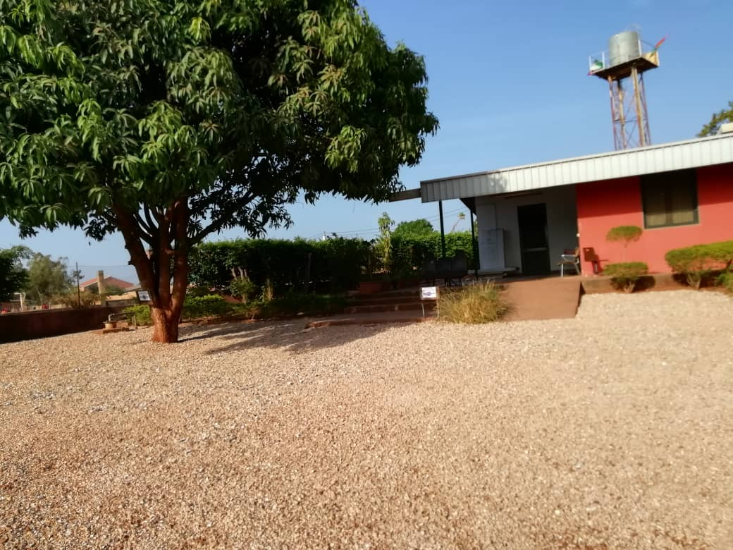
Courtyard finishing with sheels placed over the gravel in order to stabilize the soil during the rains and decrease the powder during dry season:

Slide 35
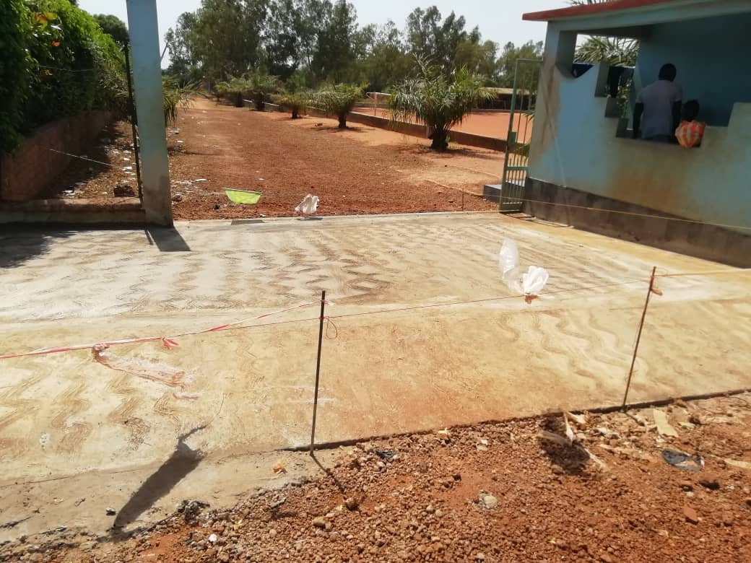
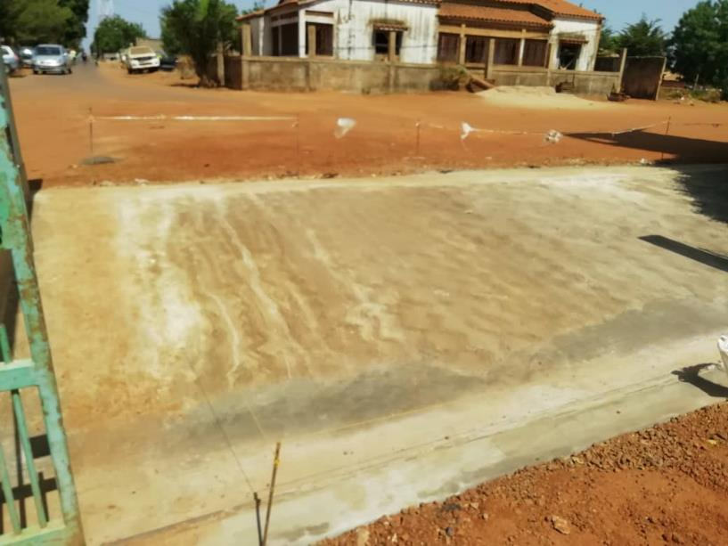
Entrance organization of Campus Madrugada

Slide 36
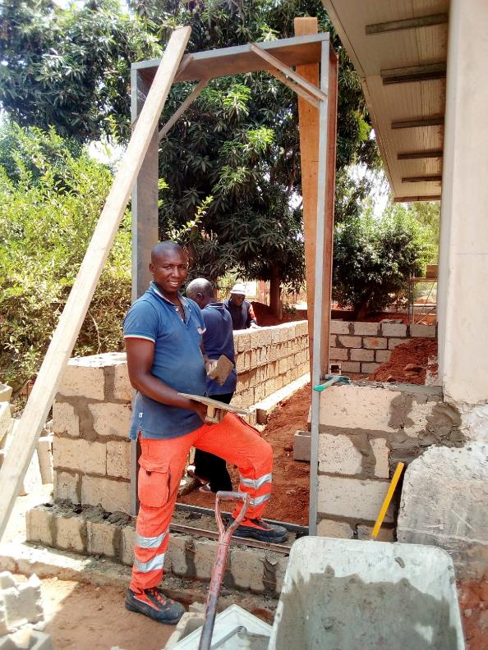
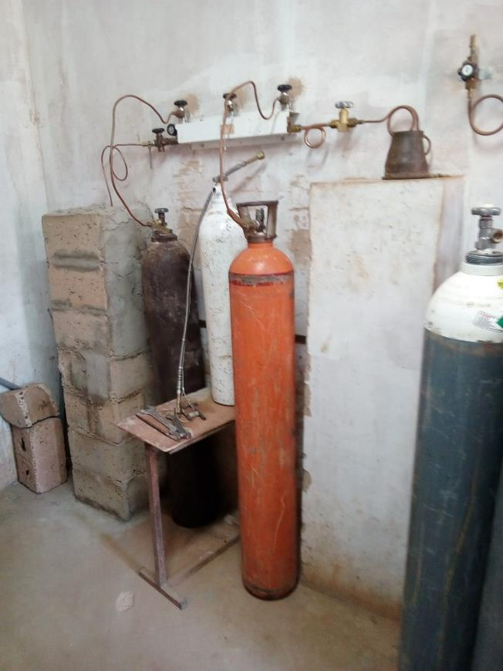
Cement screen for staff protection ot the two oxygen loading lines:
Wall construction of eletrical panel of radiology cabin

Slide 37
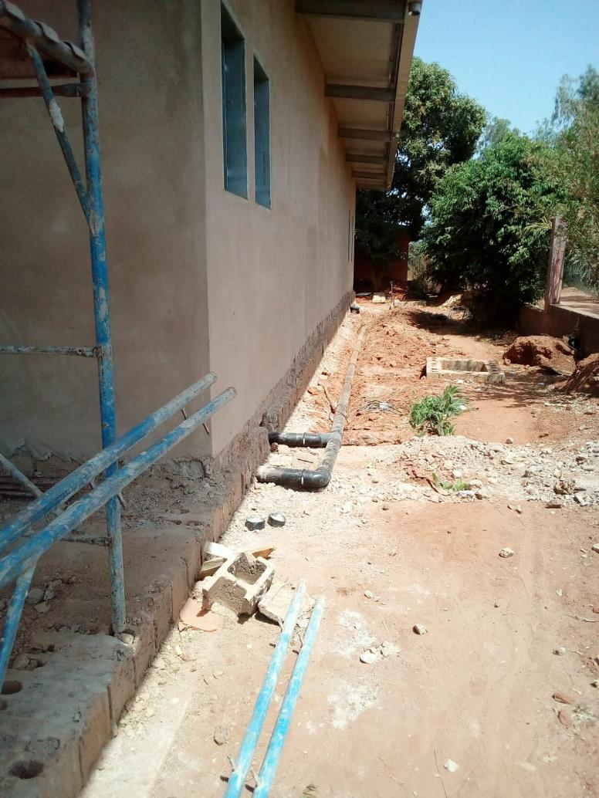
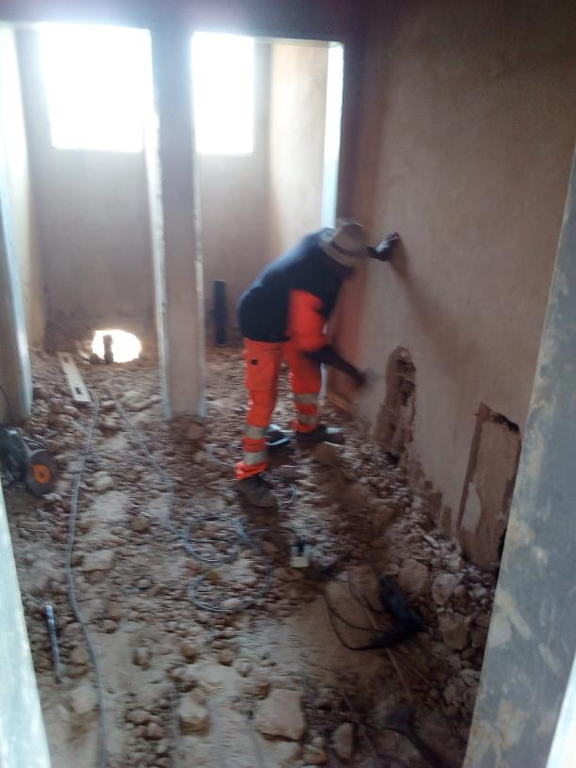
Hydraulic engineering works in the Radiology

Slide 38
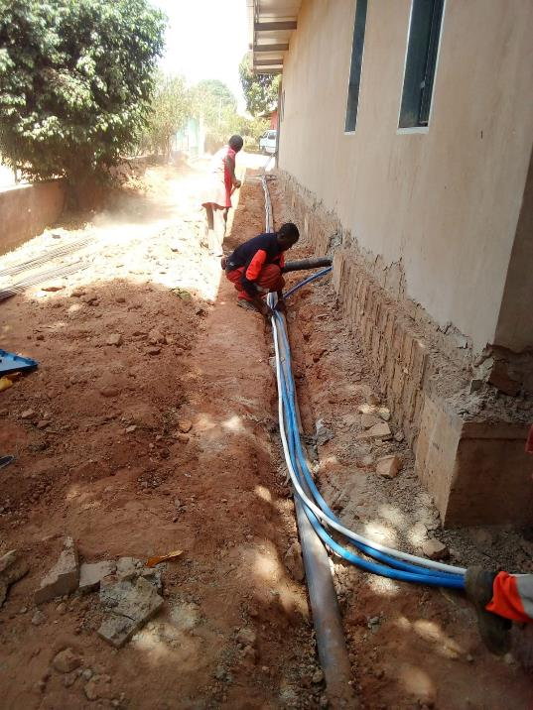
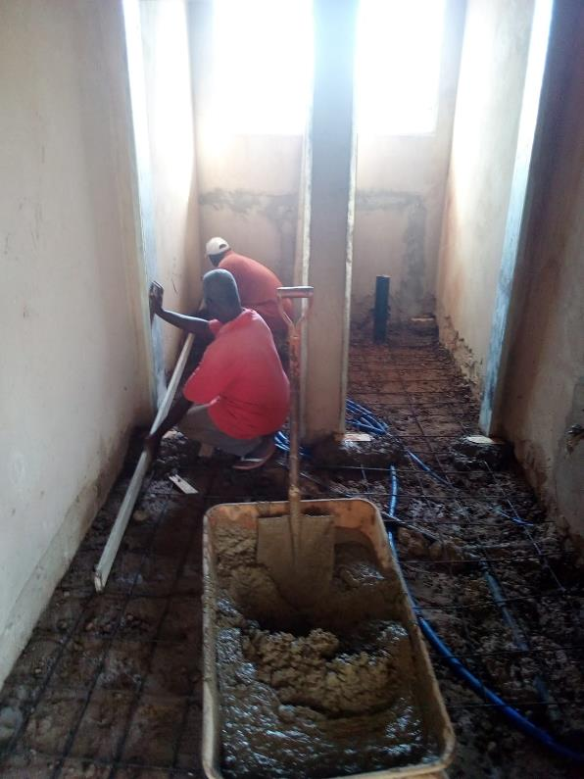

  Water pipes and drain sewers laying in the biological pit of the Radiology
Bathroom floors in the Radiology

Slide 39




Radiology sidewalks
Sewer inspection construction

Slide 40
New project «palhota»
Traditional «palhota» contruction (bungalow) which will become a shoop of foods and clothes and a meeting point (bar/restaurant). The palhota is located on the corner between the football field, the kindergardern yard and the internal road.

Slide 41


Slide 42




Slide 43


Gazebo floor of the bar

Slide 44
New space for the cleaning of surgical instruments

Slide 45



Slide 46

Partion:

Slide 47
Activities around the Radiology
Covering of the biological pit of the Radiology

Slide 48




Slide 49
School canteen
A professional kitchen has been installed in the campus and immediately started to work.

Slide 50



Slide 51
Laboratory
Laboratory Clinical Chemistry Analyzer Roche Cobas 4000 C311 installed and configured from Italy: the project was an amaizing work with an incredible result!

Slide 52


Slide 53



Slide 54


Guinean laboratory technicians at work on the new clinical analyzer Roche Cobas C311

Slide 55
Madrugada vegetable garden
Thanks to the agronomist’s work (Ansumane), the vegetable garden is growing…

Slide 56






Slide 57
New drinking water well
To guarantee the supply of drinking water…

Slide 58



… to the Campus services, particularly for future dialysis.

Slide 59
New well for drinking water
Drilling of the well carried out on the northwest side of the bakery…

Slide 60



Slide 61
Training of health personnel of the Madugada in Italy

Slide 62

To guarantee professional training to the health director of the Madrugada dr. Gabriel Jorge Sanca In internal medicine at the Verona Polyclinic

Slide 63
Verona Volunteers work
Container load with the new materials and equipments for Madrugada…

Slide 64



Slide 65


Slide 66

Madrugada continues to shine…

